Slide 1
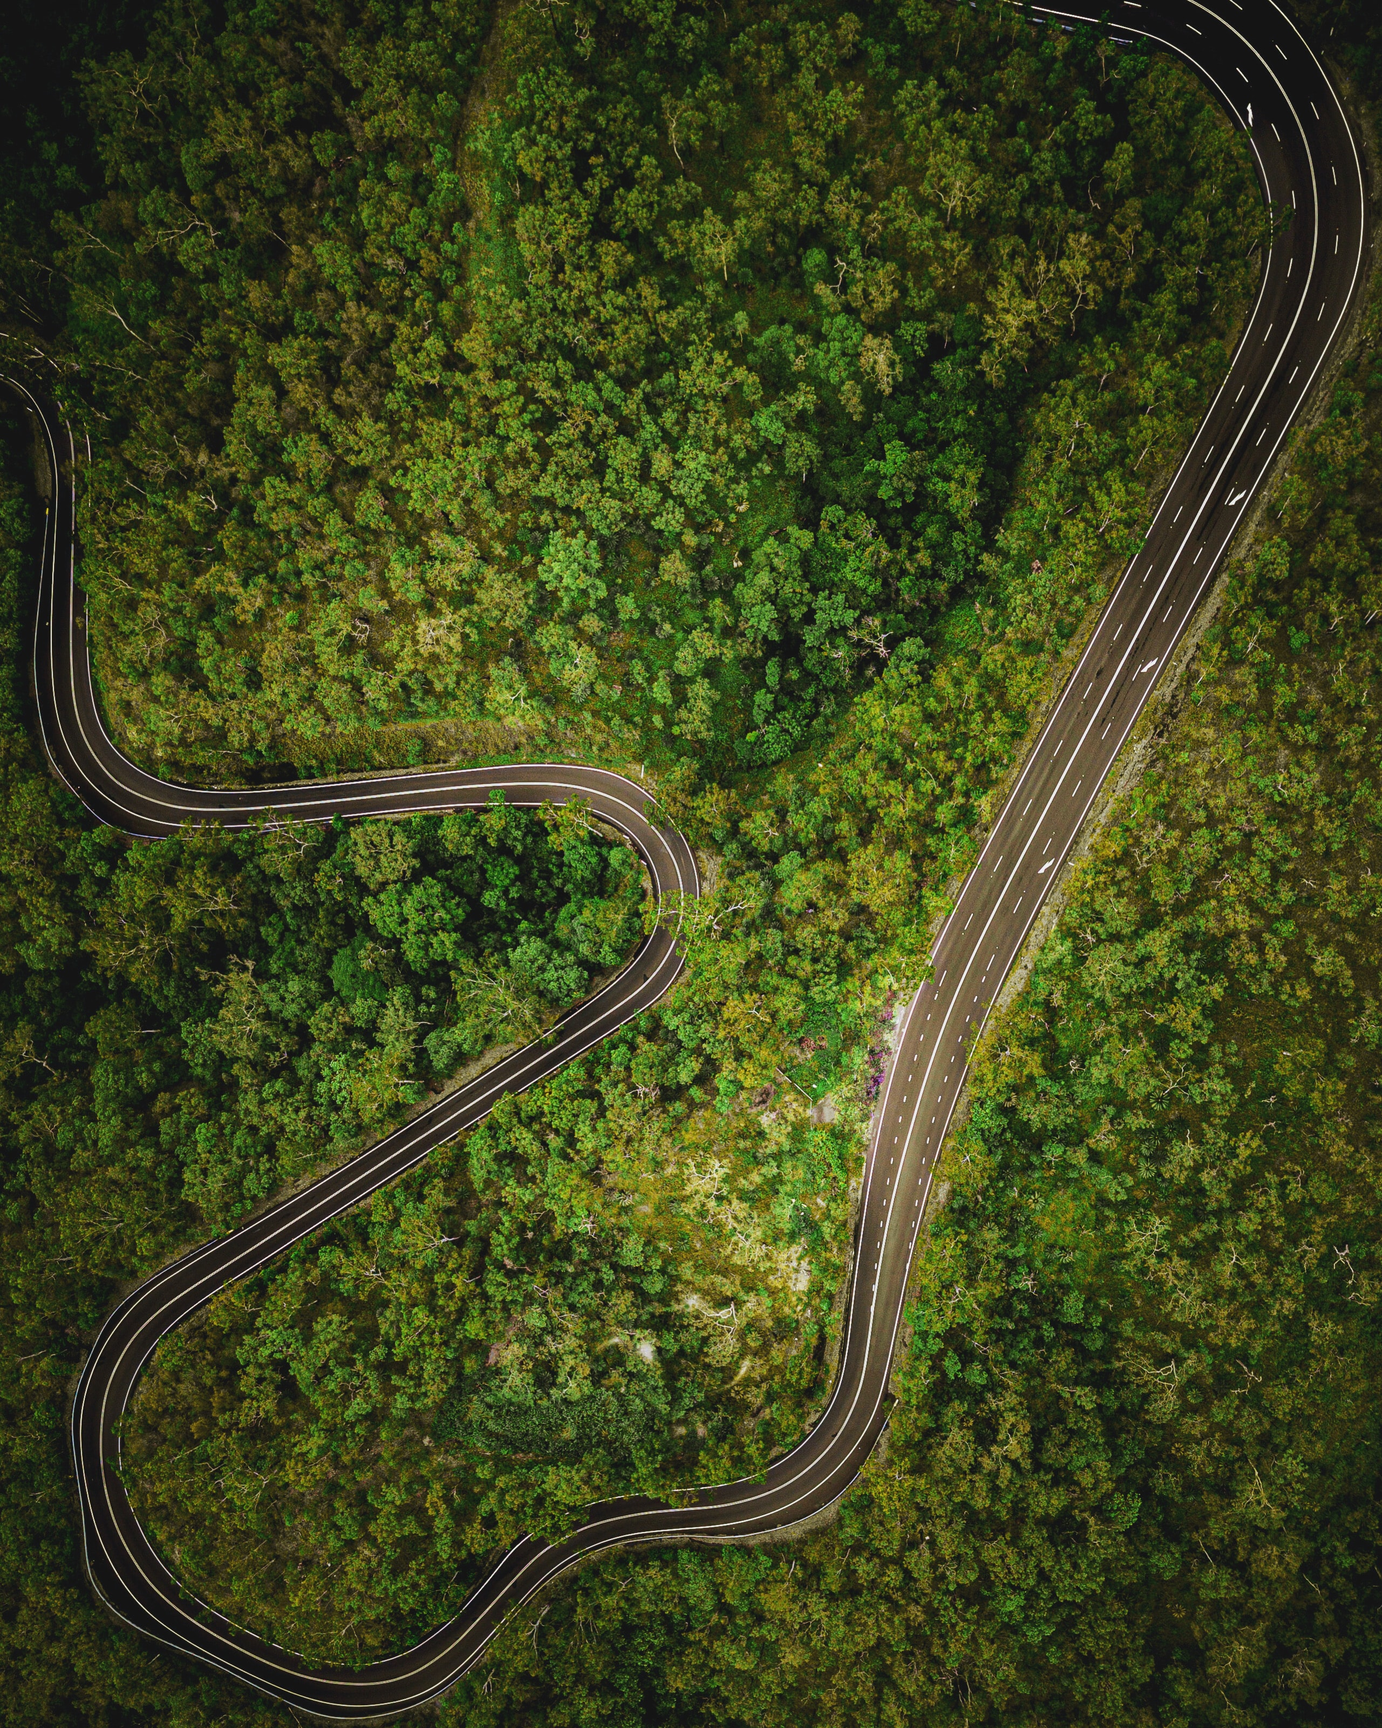



Accident Analysis
Causes and possible measures
Credit: John Lockwood

Slide 2
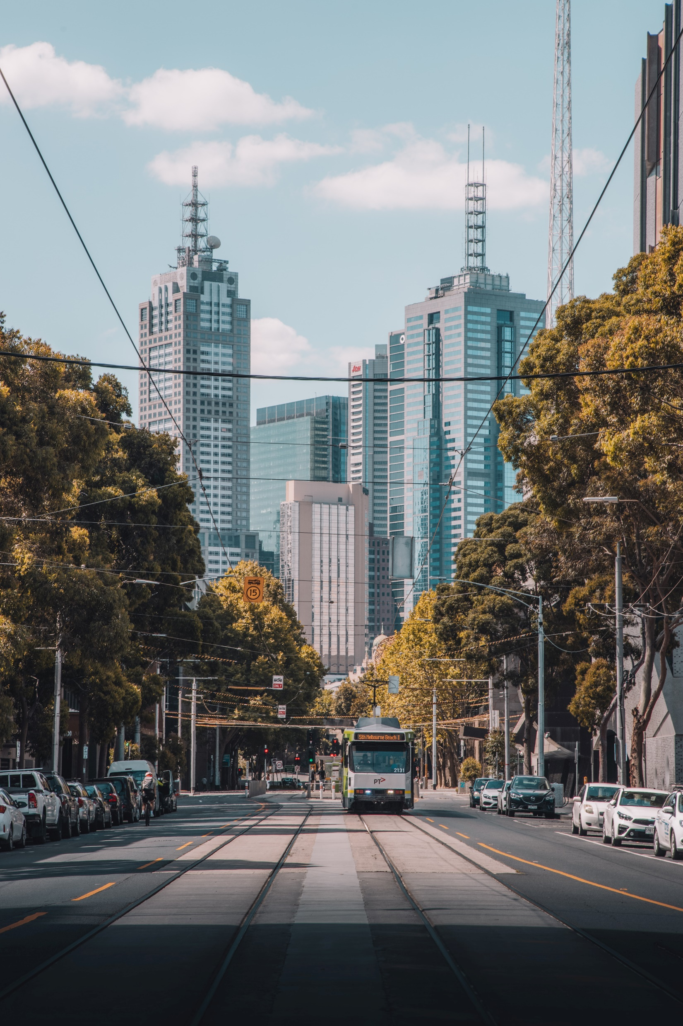
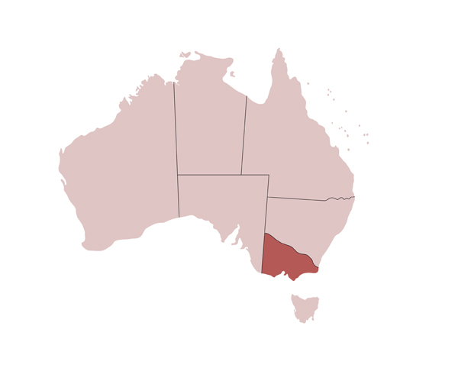
Motivations behind this preliminary study
Increase in accident numbers in the state of Victoria, after years of decline
Understand the cause to adapt the preventive and active strategy
Credit: Pat Whelen

Slide 3

Dataset used
306 000 accidents (2000 – 2020)
Time info
Day, hour
Accident details
Type and causes
Vehicles involved
Model, type, power, age
Driving conditions
Weather, Speed limit
Consequences
Severity, Injuries
Driver info
Age, Sex, Driving licence
Removed missing values
Identify/Correct/remove faulty values
Remove edge cases using AI
Dataset corrections
277 000 accidents

Slide 4
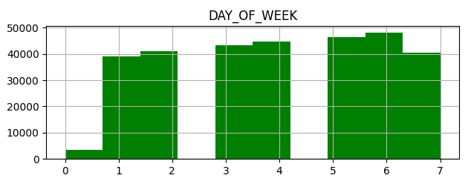
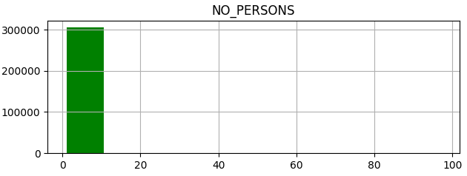
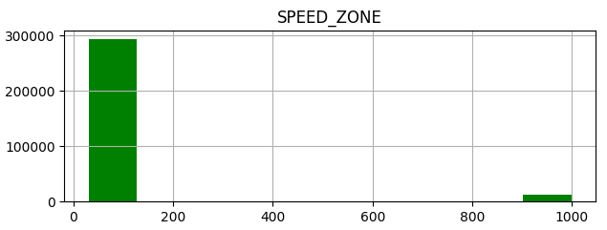
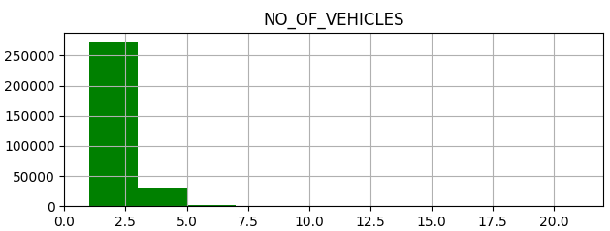
Dataset corrections
→ Remove unknown values
→ Remove edge cases

Slide 5
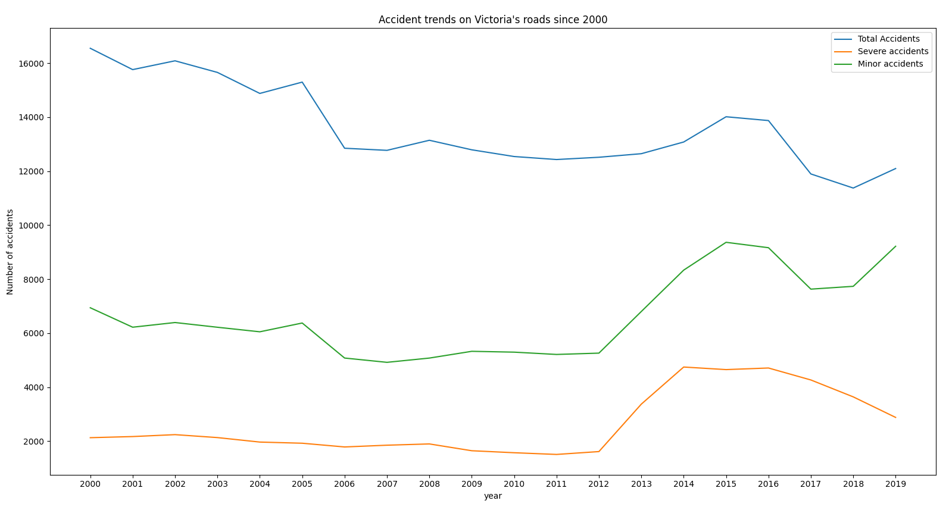
Increasing in car crashes // Can we confirm the trends ?
12096
11374
9217
7630
4266
2879

Slide 6
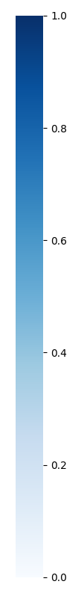
What are the causes ?
-- Atmospheric condition
-- Gender of driver
-- Surface condition
-- Age of driver
-- Speed limit
-- Vehicle age
-- Road geometry
-- Vehicle type
-- Light condition
-- Severity
-- DCA code
-- Road surface type
-- Day of week
-- Accident type
Chi2 test results for severity
0.05
0
Non discriminant
Highly discriminant

Slide 7


Preventive measures
Figures and proposal
Awareness campaign suggestions
Credit: Alessio Lin

Slide 8
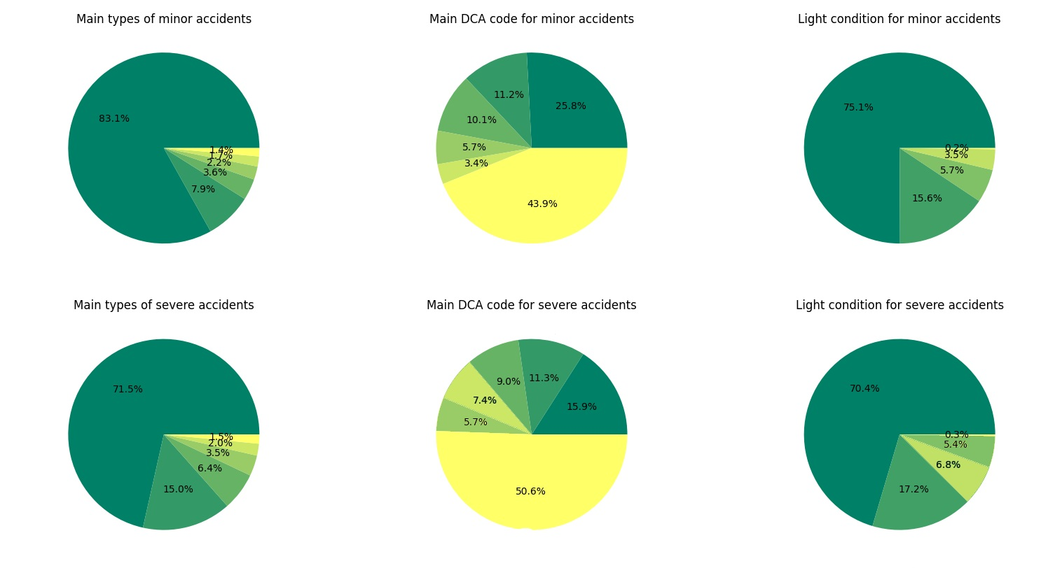
Prevention measures // Types of accident
Collision with vehicle
Collision with a fixed object
Struck pedestrian
Vehicle overturned
No collision
Others
Legend
Collision with a vehicle
Collision with an object
Collision with a vehicle
Collision with an object

Slide 9
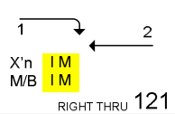
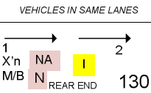
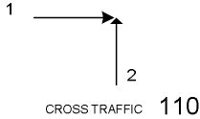
Prevention measures // DCA codes
DCA Code 130
DCA Code 121
DCA Code 110
DCA Code 113
DCA Code 120
Others
DCA Code 121
DCA Code 130
Legend
DCA Code 110
DCA Code 121
DCA Code 130
DCA Code 110

Slide 10
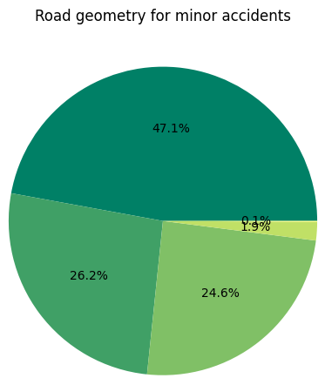
Prevention measures // Road Geometry
DCA Code 130
DCA Code 121
DCA Code 110
DCA Code 113
Others
Legend
Straight road
T intersection
Cross intersection

Slide 11
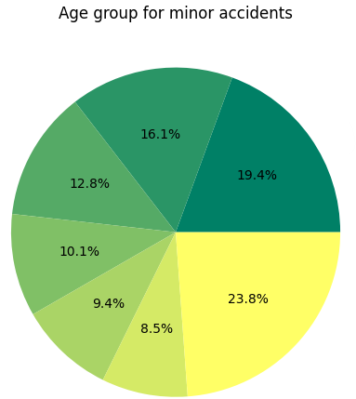
Prevention measures // Age Group
30-39
40-49
50-59
22-25
26-29
17-21
Others
40-49
Legend
50-59
30-39
17-29 ( 28% )

Slide 12
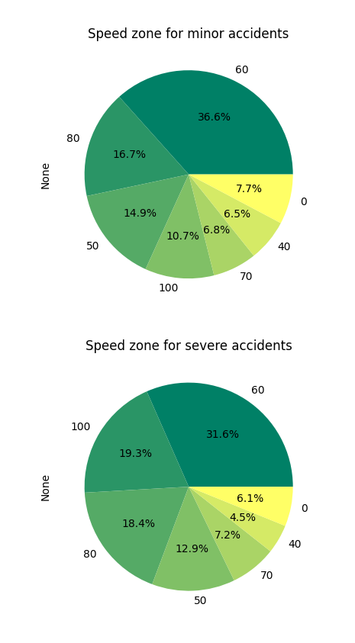
Prevention measures // Speed Limit
50-80 km/h : ~72%

Slide 13
Prevention measures // Outcomes
Most of accident: collision between vehicles in the same lane, one following another
Straight Road
At low speed
→ Awareness campaigns should focus on travels where the driver feels safe and loose attention
Drivers mainly aged of 17-29
Second category: 30-39
→ They should target specific range of the population
Most of minor accidents in speed zones 60
In straight roads
→ Besides, changing speed limits, increasing speed controls and renovate certain roads could help

Slide 14


Prevention measures // Typical target profile
Daily commute
Aged 22-25 & 30-39
Easily distracted
Self-confident driver
Small roads (60 km/h)

Slide 15
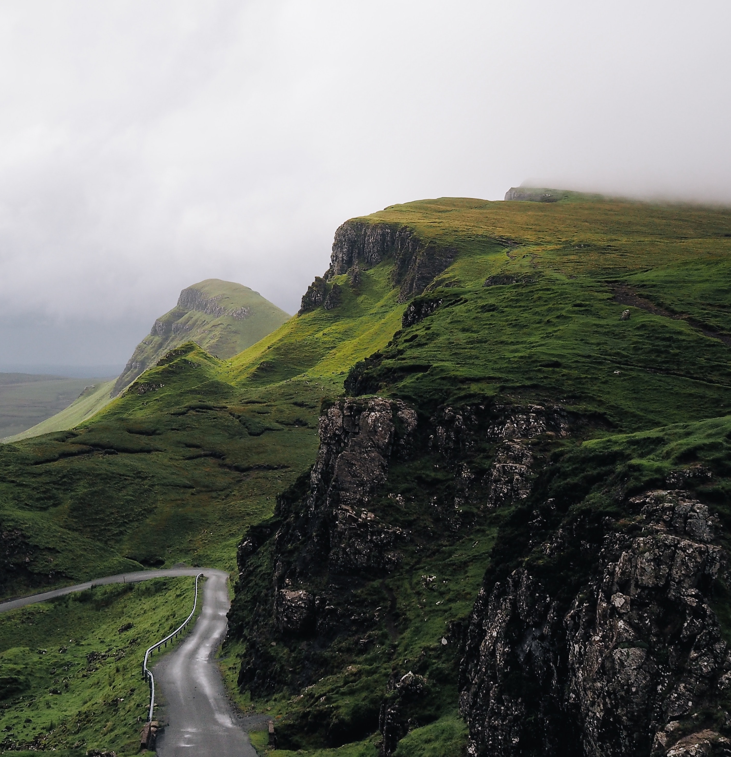
Questions ?
Possible further work
Use clustering ML methods to locate the epicentre of these accidents
Observe the evolution of these features in time to identify which one cause the increase
Complete the missing values in dataset using regression

